Slide 1

Phase 1, Module 11: Object-Oriented Programming (OOP)
Building Industrial-Grade Blueprints
Until now, we have been writing code as a series of steps. Today, we shift our mindset. We will learn how to group data and behavior together into 'Objects.' This is how large-scale AI frameworks like PyTorch and TensorFlow are built.
Presented By: Zaryab Ahmad

Slide 2
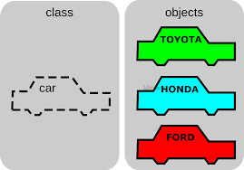
What is a Class? (The Blueprint)
Blueprints vs. Objects
Class: The architectural drawing (e.g., a "Car" design).
Object (Instance): The physical item built from that drawing (e.g., your specific Car).
The Goal: Write the logic once in a Class, then create 1,000 unique Objects from it.

Slide 3
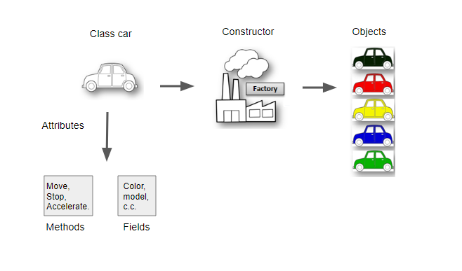

Attributes and Methods
State and Behavior
Attributes (Data): What the object is (e.g., color, model, speed).
Methods (Functions): What the object does (e.g., start_engine, accelerate).
$self:$The keyword that allows an object to "talk" to its own data.

Slide 4
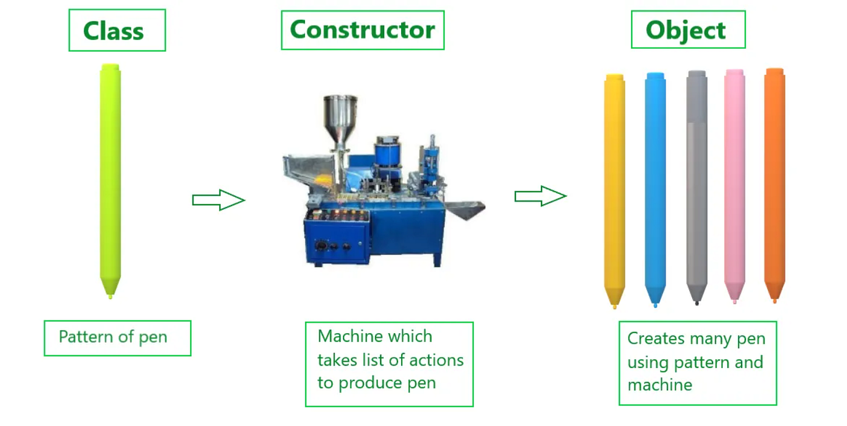


The Constructor $(__init__)$
The Birth of an Object
The $__init__$method runs automatically the microsecond an object is created.
It sets the initial state of the object (e.g., setting the patient ID or loading the AI model weights).

Slide 5
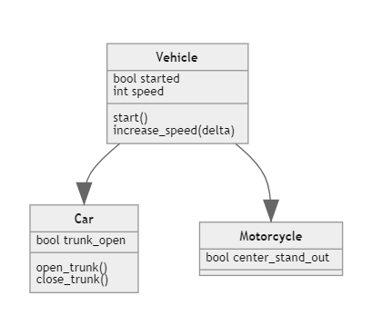

Inheritance (Professional Hierarchy)
Don't Rebuild, Inherit
A "Child" class can take all the features of a "Parent" class.
Use Case: A generic Sensor $class (Parent) ➔ A TemperatureSensor class (Child).$

